Slide 1
CSCE430/830 Computer Architecture
Instruction-level parallelism: Tomasulo
Lecturer: Prof. Hong Jiang
Courtesy of Yifeng Zhu (U. Maine)
Fall, 2006
Portions of these slides are derived from:
Dave Patterson © UCB

Slide 2
Another Dynamic Algorithm:
Tomasulo’s Algorithm
For IBM 360/91 (before caches!)
Goal: High Performance without special compilers
Small number of floating point registers (4 in 360) prevented interesting compiler scheduling of operations
  This led Tomasulo to try to figure out how to get more effective registers — renaming in hardware!
Why Study 1966 Computer?
The descendants of this have flourished!
  Alpha 21264, HP 8000, MIPS 10000, Pentium III, PowerPC 604, …

Slide 3
Tomasulo’s Algorithm
Tracks when operands for instructions are available.
  Minimizes RAW hazards.
  Introduces register renaming to minimize WAW and WAR hazards.
Supports the overlapped execution of multiple iterations of a loop.

Slide 4
Avoiding Hazards
RAW
  Execute an instruction only when its operands are available.
WAW and WAR
  Register renaming

Slide 5
Register Renaming (Example)
Eliminates WAR and WAW hazards by renaming all destination registers.
Can be done by compiler
DIV.D F0, F2, F4
ADD.D F6, F0, F8
S.D F6, 0(R1)
SUB.D F8, F10, F14
MUL.D F6, F10, F8
Antidependence
S, T: temporary registers
Output dependence
DIV.D F0, F2, F4
ADD.D S, F0, F8
S.D S, 0(R1)
SUB.D T, F10, F14
MUL.D F6, F10, T

Slide 6
Tomasulo’s Algorithm
Register renaming is provided by the reservation stations, which buffer the operands of instructions waiting to issue, and by the issue logic.
A reservation station fetches and buffers an operand as soon as it is available, eliminating the need to get the operand from a register.

Slide 7
Tomasulo Organization
FP Op
Queue
FP Registers
From Mem
Load Buffers
Load1
Load2
Load3
Load4
Load5
Load6
Store
Buffers
Add1
Add2
Add3
Mult1
Mult2
Reservation
Stations
To Mem
FP adders
FP multipliers
Common Data Bus (CDB)
Normal data bus: data + destination
Common data bus: data + source
Notes:
Resolve RAW memory conflict? (address in memory buffers)
Integer unit executes in parallel

Slide 8
Tomasulo Algorithm: A Decentralized One
Control & buffers distributed with Function Units (FU)
  FU buffers called “reservation stations”; have pending operands
Registers in instructions replaced by values or pointers to reservation stations(RS);
  form of register renaming ;
  avoids WAR, WAW hazards
  more reservation stations than registers, so can do optimizations compilers can’t
Results to FU from RS, not through registers, over Common Data Bus that broadcasts results to all FUs
Loads and Stores treated as FUs with RSs as well
Integer instructions can go past branches, allowing
FP ops beyond basic block in FP queue

Slide 9
Three Stages of Tomasulo Algorithm
1. Issue—get instruction from FP Op Queue
  If reservation station free (no structural hazard),
  control issues instr & sends operands (renames registers).
2. Execute—operate on operands (EX)
  When both source operands are ready then execute;
  if not ready, watch Common Data Bus for result
3. Write result—finish execution (WB)
  Write on Common Data Bus to all awaiting units;
  mark reservation station available
Normal data bus: data + destination (“go to” bus)
Common data bus: data + source (“come from” bus)
  64 bits of data + 4 bits of Functional Unit source address
  Write if matches expected Functional Unit (produces result)
  Does the broadcast
Example speed:
3 clocks for Fl .pt. +,-; 10 for * ; 40 clks for /

Slide 10
Reservation Station Components
Op: Operation to perform in the unit (e.g., + or –)
Vj, Vk: Value of Source operands
  Store buffers has V field, result to be stored
Qj, Qk: Reservation stations producing source registers (value to be written)
  Note: Qj,Qk=0 => ready
  Store buffers only have Qi for RS producing result
Busy: Indicates reservation station or FU is busy
Register result status—Indicates which functional unit will write each register, if one exists. Blank when no pending instructions that will write that register.
Notes:
What you might have thought
1. 4 stages of instruction executino
2.Status of FU: Normal things to keep track of (RAW & structura for busyl):
Fi from instruction format of the mahine (Fi is dest)
Add unit can Add or Sub
Rj, Rk - status of registers (Yes means ready)
Qj,Qk - If a no in Rj, Rk, means waiting for a FU to write result; Qj, Qk means wihch FU waiting for it
3.Status of register result (WAW &WAR)s:
which FU is going to write into registers
Scoreboard on 6600 = size of FU
6.7, 6.8, 6.9, 6.12, 6.13, 6.16, 6.17
FU latencies: Add 2, Mult 10, Div 40 clocks

Slide 11
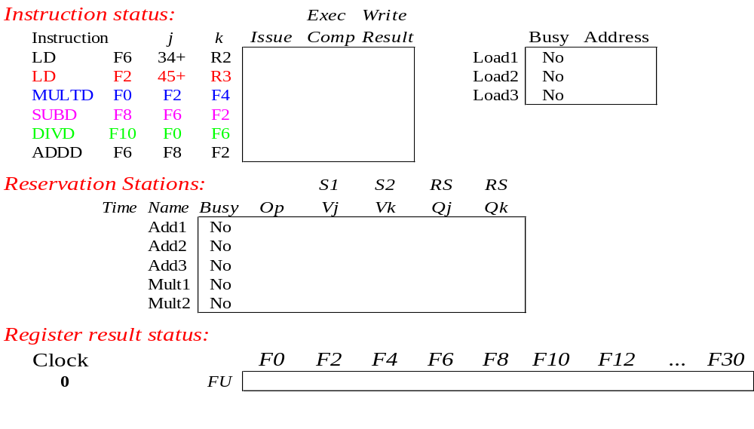
Tomasulo Example
Instruction stream
3 Load/Buffers
FU count
down
3 FP Adder R.S.
2 FP Mult R.S.
Clock cycle
counter

Slide 12
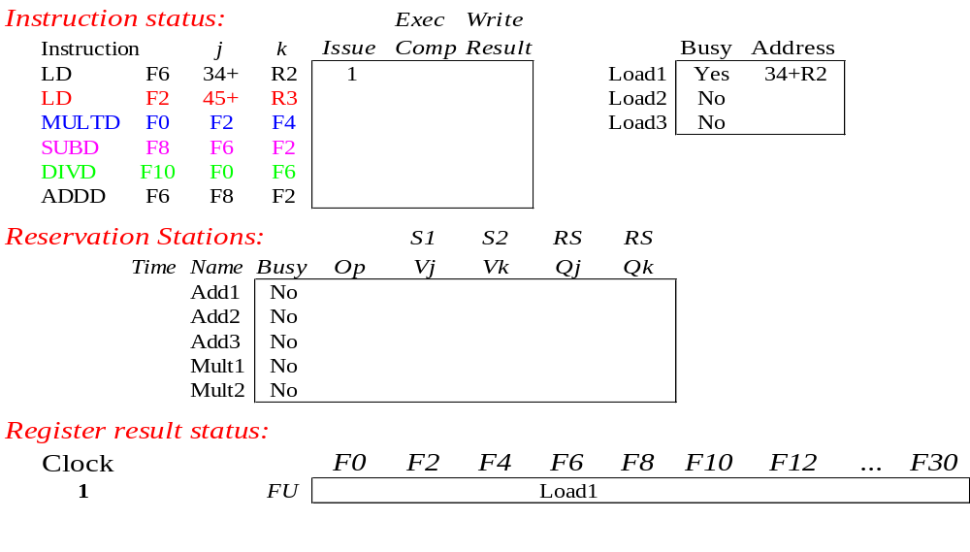
Tomasulo Example Cycle 1

Slide 13
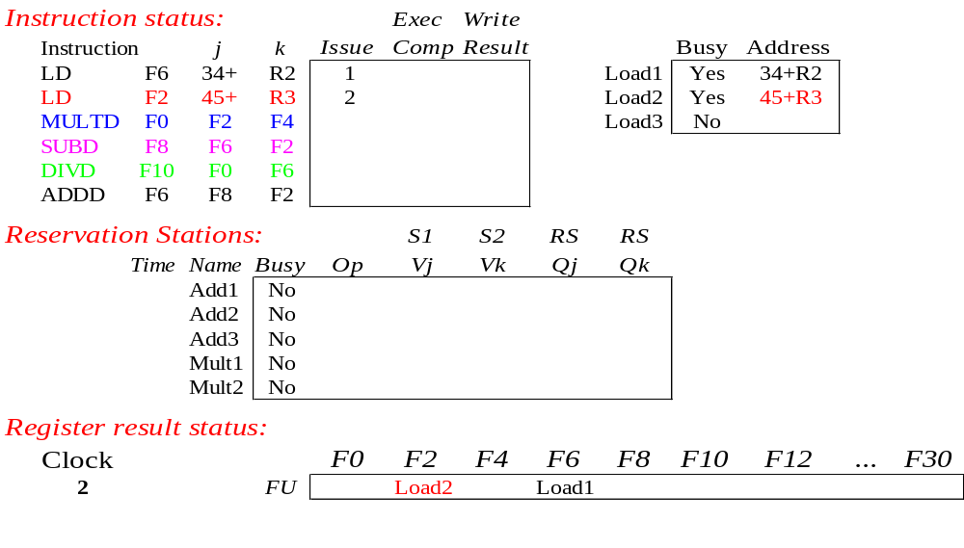
Tomasulo Example Cycle 2
Note: Can have multiple loads outstanding

Slide 14
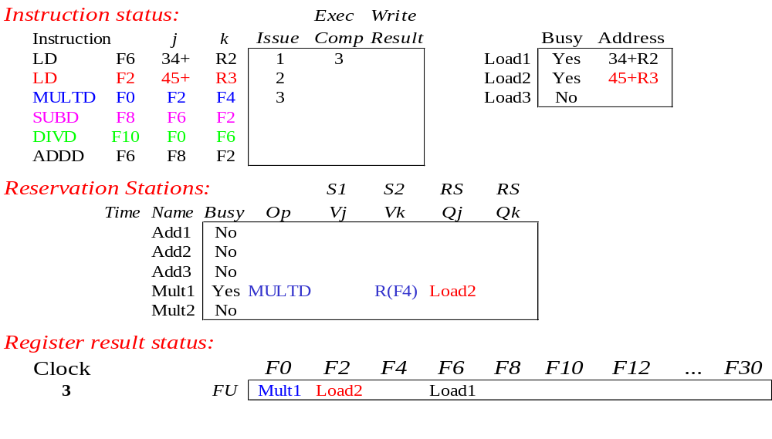
Tomasulo Example Cycle 3
Note: registers names are removed (“renamed”) in Reservation Stations; MULT issued
Load1 completing; what is waiting for Load1?

Slide 15
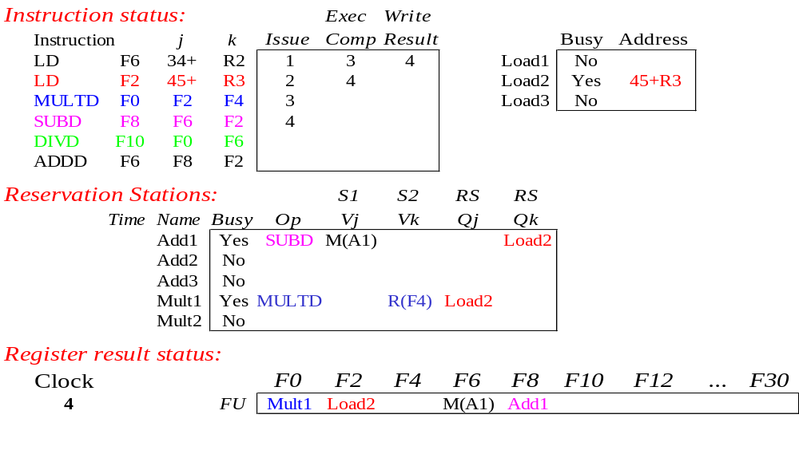
Tomasulo Example Cycle 4
Load2 completing; what is waiting for Load2?

Slide 16
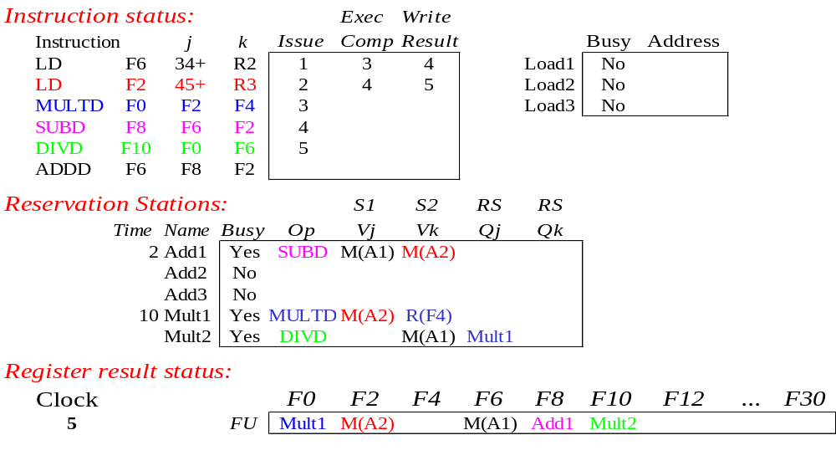
Tomasulo Example Cycle 5
Timer starts down for Add1, Mult1

Slide 17
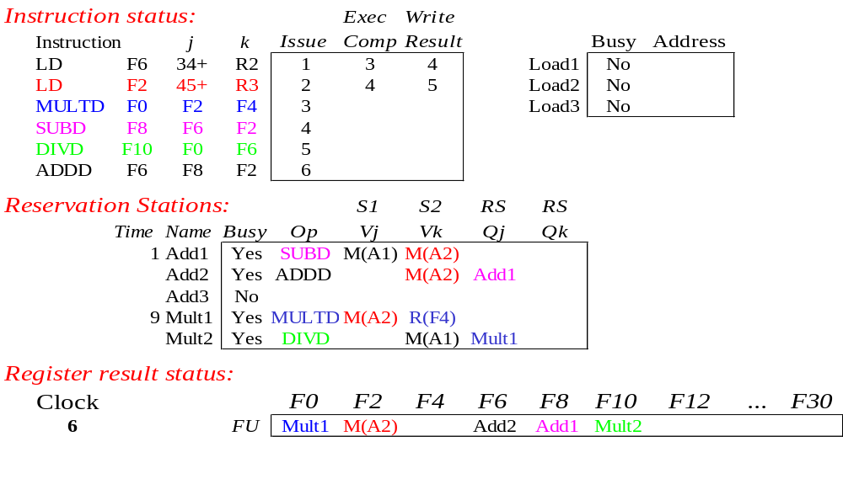
Tomasulo Example Cycle 6
Issue ADDD here despite name dependency on F6?

Slide 18

Tomasulo Example Cycle 7
Add1 (SUBD) completing; what is waiting for it?

Slide 19
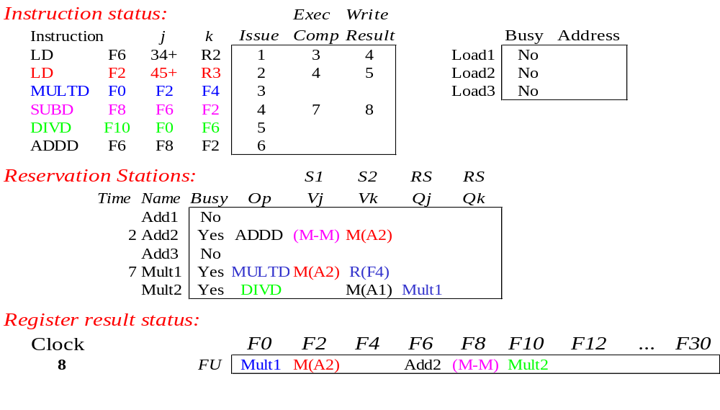
Tomasulo Example Cycle 8

Slide 20

Tomasulo Example Cycle 9

Slide 21

Tomasulo Example Cycle 10
Add2 (ADDD) completing; what is waiting for it?

Slide 22
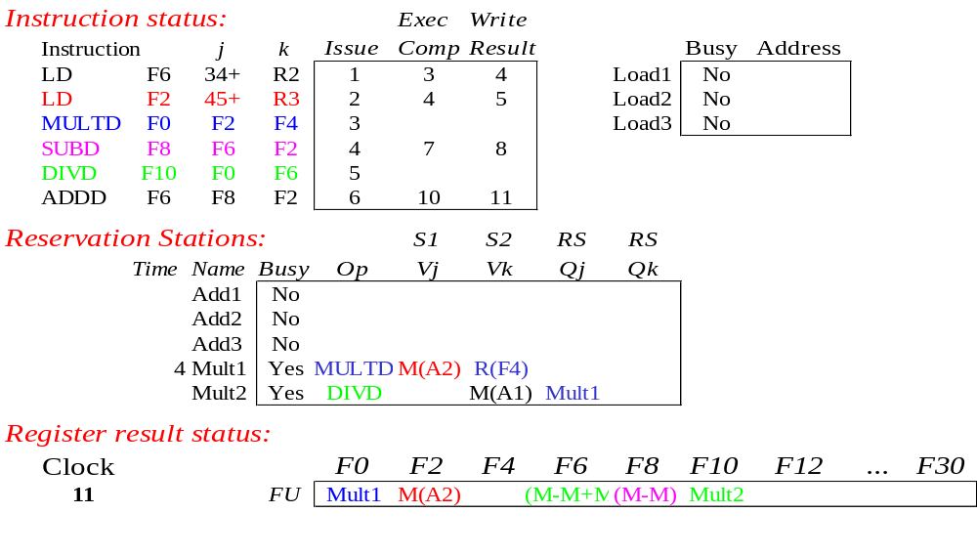
Tomasulo Example Cycle 11
Write result of ADDD here?
All quick instructions complete in this cycle!

Slide 23

Tomasulo Example Cycle 12

Slide 24

Tomasulo Example Cycle 13

Slide 25

Tomasulo Example Cycle 14

Slide 26
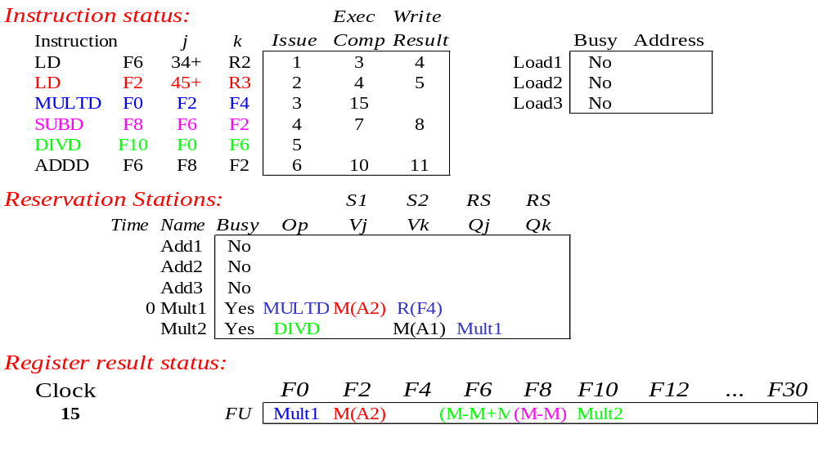
Tomasulo Example Cycle 15
Mult1 (MULTD) completing; what is waiting for it?

Slide 27
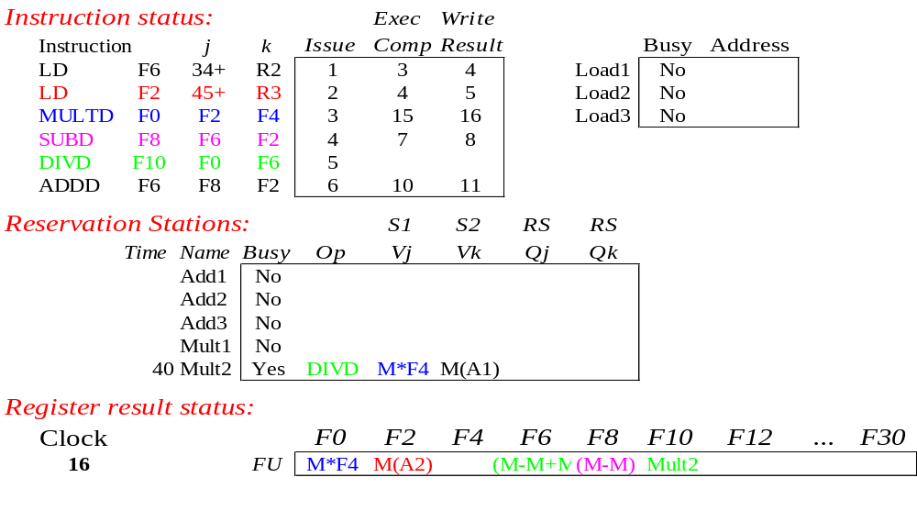
Tomasulo Example Cycle 16
Just waiting for Mult2 (DIVD) to complete

Slide 28
Faster than light computation
(skip a couple of cycles)

Slide 29
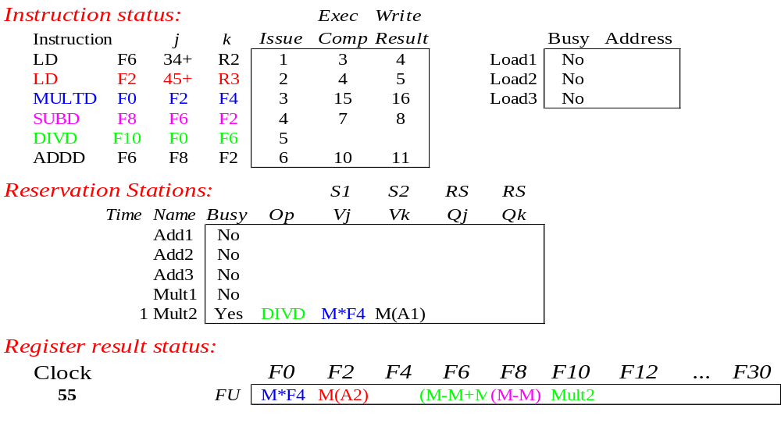
Tomasulo Example Cycle 55

Slide 30
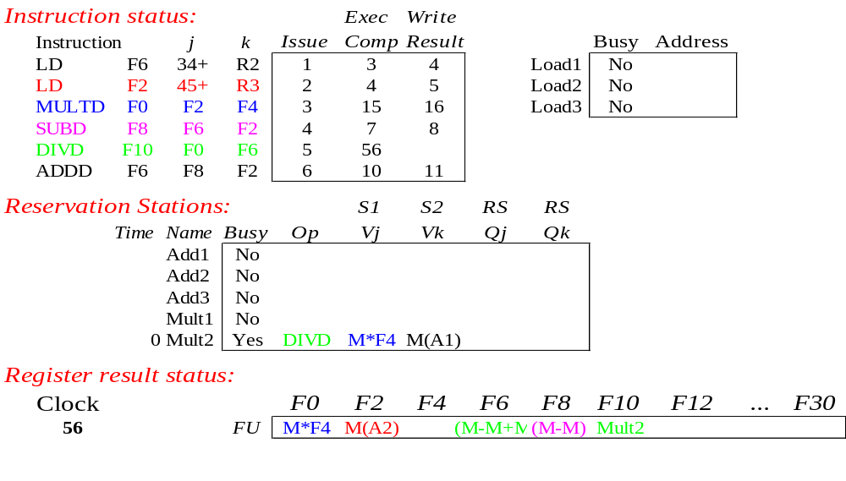
Tomasulo Example Cycle 56
Mult2 (DIVD) is completing; what is waiting for it?

Slide 31
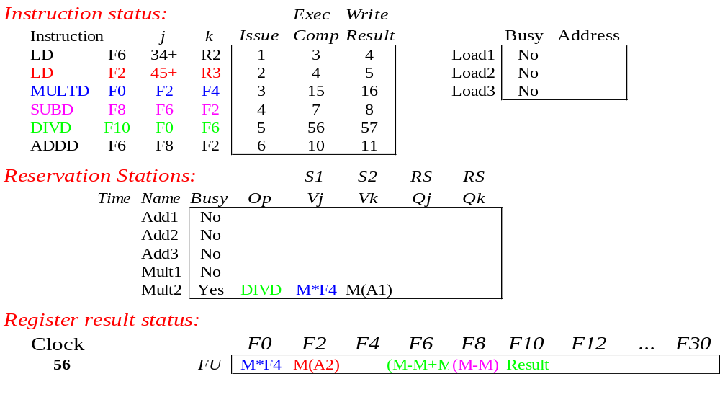
Tomasulo Example Cycle 57
Once again: In-order issue, out-of-order execution and out-of-order completion.

Slide 32
Tomasulo Drawbacks
Complexity
  delays of 360/91, MIPS 10000, Alpha 21264,
  IBM PPC 620 in CA:AQA 2/e, but not in silicon!
Many associative stores (CDB) at high speed
Performance limited by Common Data Bus
  Each CDB must go to multiple functional units
  ⇒high capacitance, high wiring density
  Number of functional units that can complete per cycle limited to one!
    Multiple CDBs ⇒ more FU logic for parallel assoc stores
Non-precise interrupts!
  We will address this later

Slide 33
Avoiding Hazards
RAW
  Execute an instruction only when its operands are available.
WAW and WAR
  Register renaming

Slide 34
Tomasulo Organization
FP Op
Queue
FP Registers
From Mem
Load Buffers
Load1
Load2
Load3
Load4
Load5
Load6
Store
Buffers
Add1
Add2
Add3
Mult1
Mult2
Reservation
Stations
To Mem
FP adders
FP multipliers
Common Data Bus (CDB)
Notes:
Resolve RAW memory conflict? (address in memory buffers)
Integer unit executes in parallel

Slide 35
Three Stages of Tomasulo Algorithm
1. Issue—get instruction from FP Op Queue
  If reservation station free (no structural hazard),
  control issues instr & sends operands (renames registers).
2. Execute—operate on operands (EX)
  When both operands ready then execute;
  if not ready, watch Common Data Bus for result
3. Write result—finish execution (WB)
  Write on Common Data Bus to all awaiting units;
  mark reservation station available
Normal data bus: data + destination (“go to” bus)
Common data bus: data + source (“come from” bus)
  64 bits of data + 4 bits of Functional Unit source address
  Write if matches expected Functional Unit (produces result)
  Does the broadcast
Example speed:
3 clocks for Fl .pt. +,-; 10 for * ; 40 clks for /

Slide 36
Reservation Station Components
Op: Operation to perform in the unit (e.g., + or –)
Vj, Vk: Value of Source operands
  Store buffers has V field, result to be stored
Qj, Qk: Reservation stations producing source registers (value to be written)
  Note: Qj,Qk=0 => ready
  Store buffers only have Qi for RS producing result
Busy: Indicates reservation station or FU is busy
Register result status—Indicates which functional unit will write each register, if one exists. Blank when no pending instructions that will write that register.
Notes:
What you might have thought
1. 4 stages of instruction executino
2.Status of FU: Normal things to keep track of (RAW & structura for busyl):
Fi from instruction format of the mahine (Fi is dest)
Add unit can Add or Sub
Rj, Rk - status of registers (Yes means ready)
Qj,Qk - If a no in Rj, Rk, means waiting for a FU to write result; Qj, Qk means wihch FU waiting for it
3.Status of register result (WAW &WAR)s:
which FU is going to write into registers
Scoreboard on 6600 = size of FU
6.7, 6.8, 6.9, 6.12, 6.13, 6.16, 6.17
FU latencies: Add 2, Mult 10, Div 40 clocks

Slide 37
Tomasulo Loop Example
Loop: LD F0 0 R1
MULTD F4 F0 F2
SD F4 0 R1
SUBI R1 R1 #8
BNEZ R1 Loop
This time assume Multiply takes 4 clocks
Assume 1st load takes 8 clocks
(L1 cache miss), 2nd load takes 1 clock (hit)
To be clear, will show clocks for SUBI, BNEZ
  Reality: integer instructions ahead of Fl. Pt. Instructions
Show 2 iterations

Slide 38
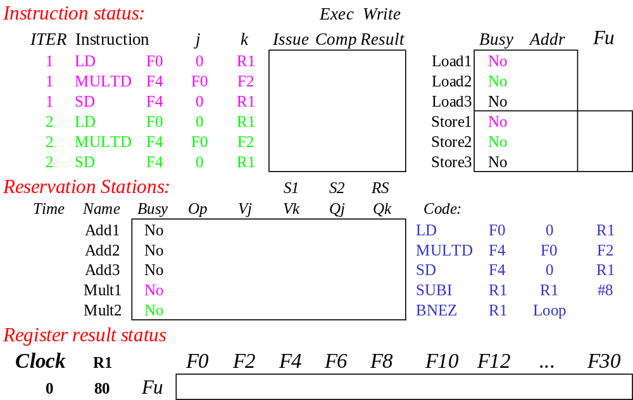
Loop Example
Iter-
ation
Count
Added Store Buffers
Instruction Loop
Value of Register used for address, iteration control

Slide 39
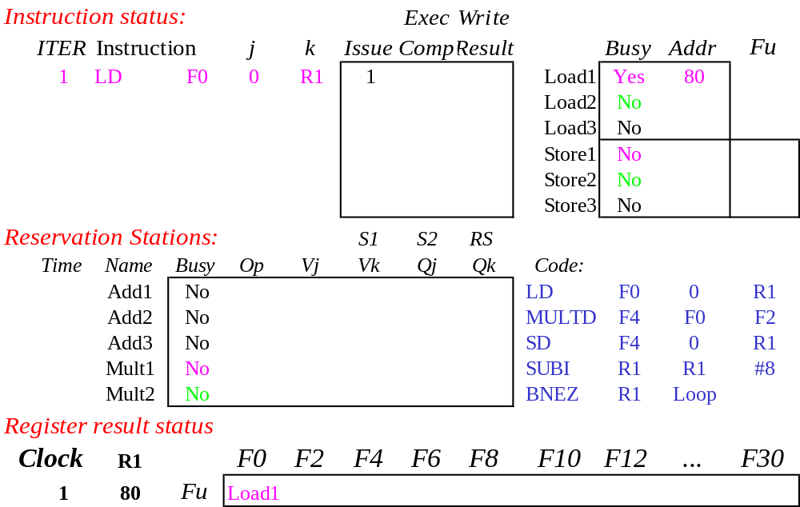
Loop Example Cycle 1

Slide 40
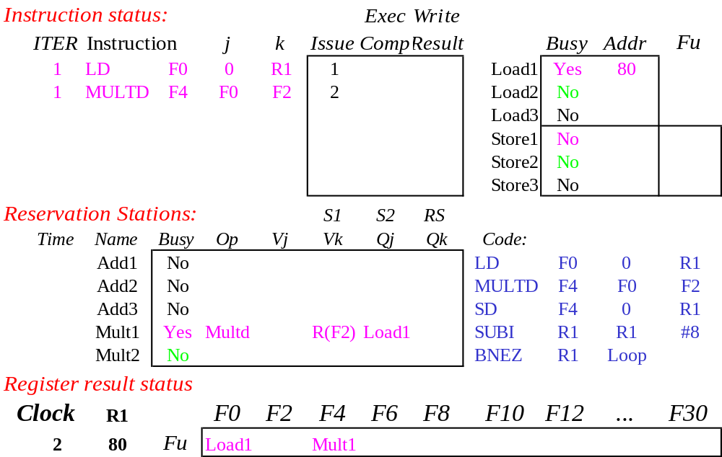
Loop Example Cycle 2

Slide 41
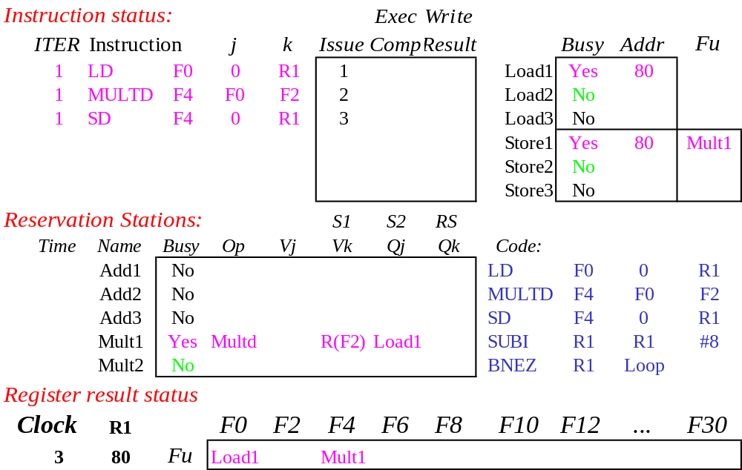
Loop Example Cycle 3
Implicit renaming sets up data flow graph

Slide 42

Loop Example Cycle 4
Dispatching SUBI Instruction (not in FP queue)

Slide 43

Loop Example Cycle 5
And, BNEZ instruction (not in FP queue)

Slide 44
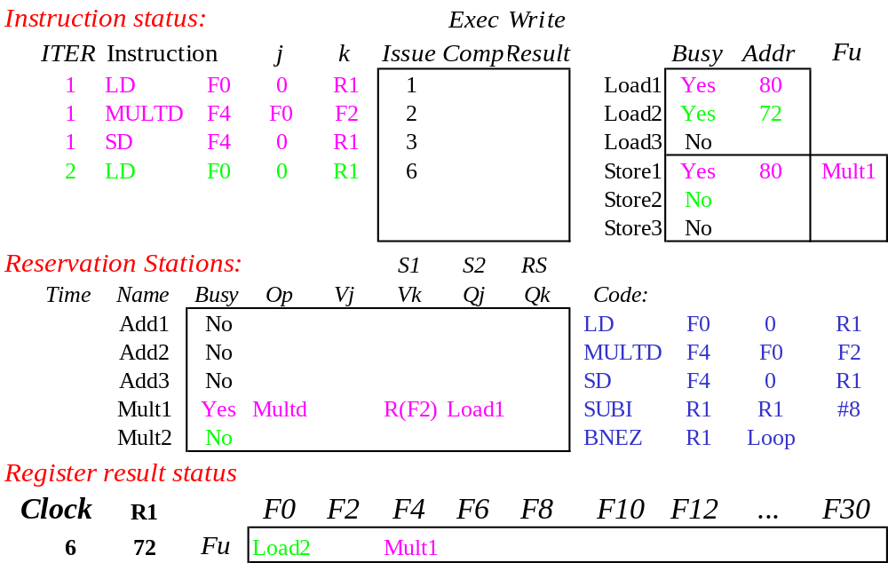
Loop Example Cycle 6
Notice that F0 never sees Load from location 80

Slide 45
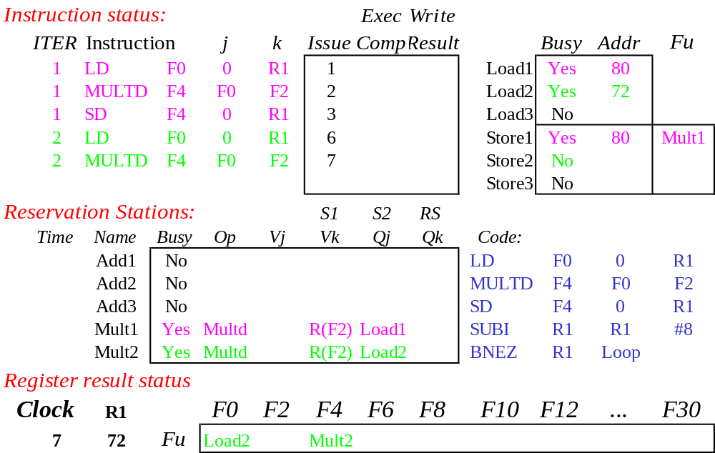
Loop Example Cycle 7
Register file completely detached from computation
First and Second iteration completely overlapped

Slide 46

Loop Example Cycle 8

Slide 47
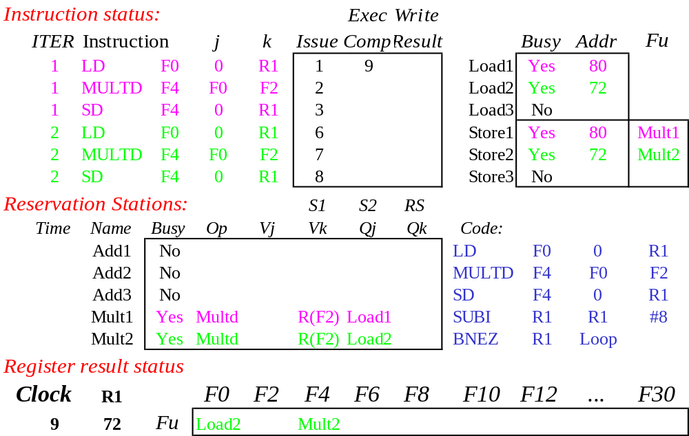
Loop Example Cycle 9
Load1 completing: who is waiting?
Note: Dispatching SUBI

Slide 48
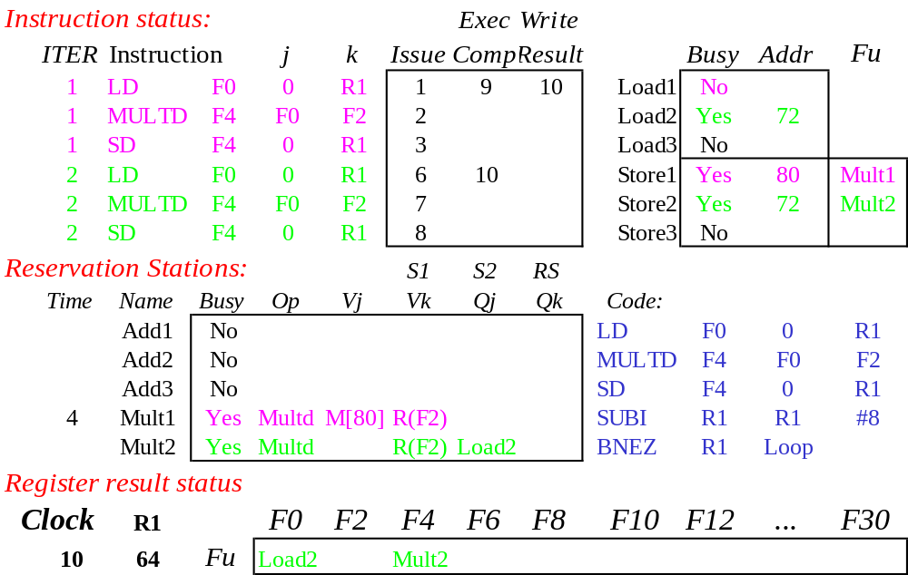
Loop Example Cycle 10
Load2 completing: who is waiting?
Note: Dispatching BNEZ

Slide 49
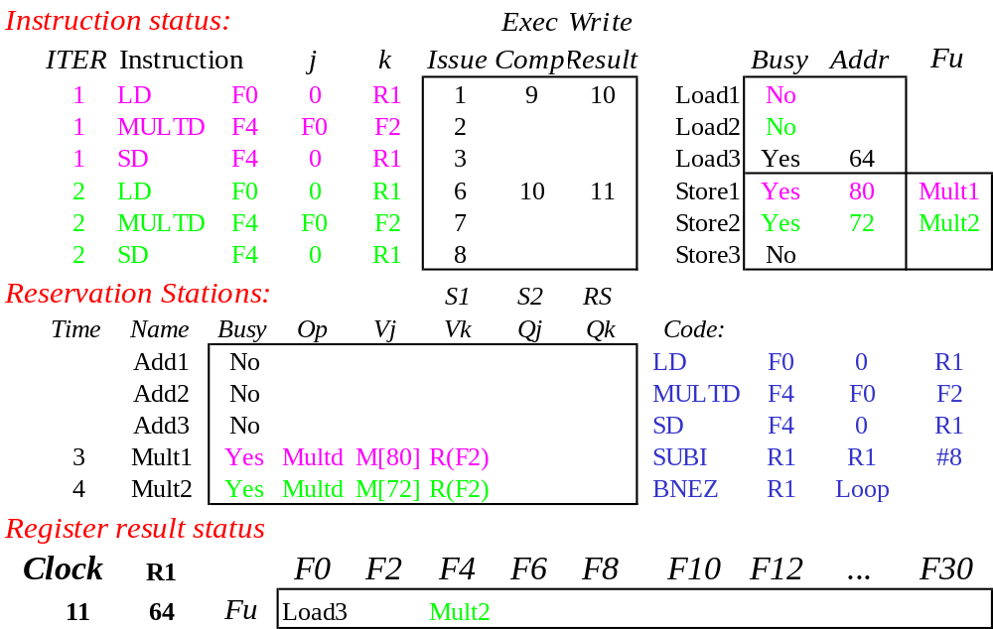
Loop Example Cycle 11
Next load in sequence

Slide 50

Loop Example Cycle 12
Why not issue third multiply?

Slide 51

Loop Example Cycle 13
Why not issue third store?

Slide 52
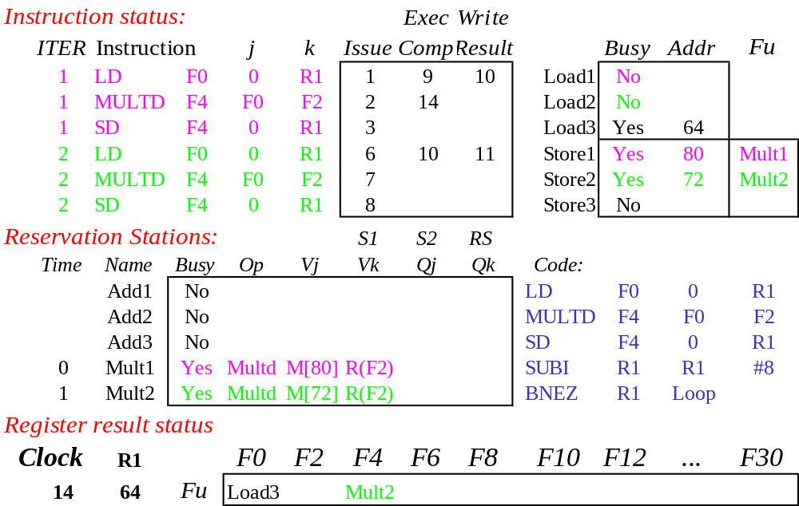
Loop Example Cycle 14
Mult1 completing. Who is waiting?

Slide 53
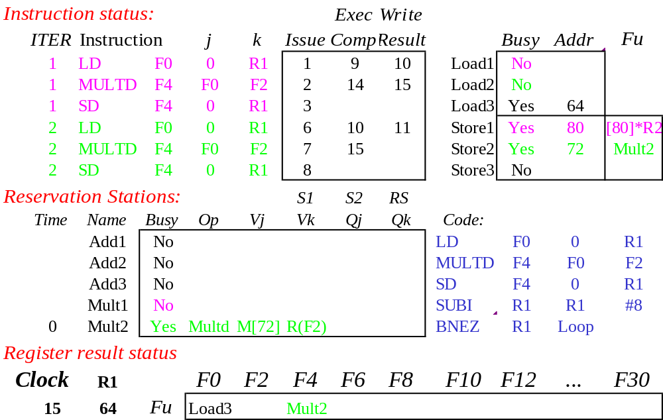
Loop Example Cycle 15
Mult2 completing. Who is waiting?

Slide 54
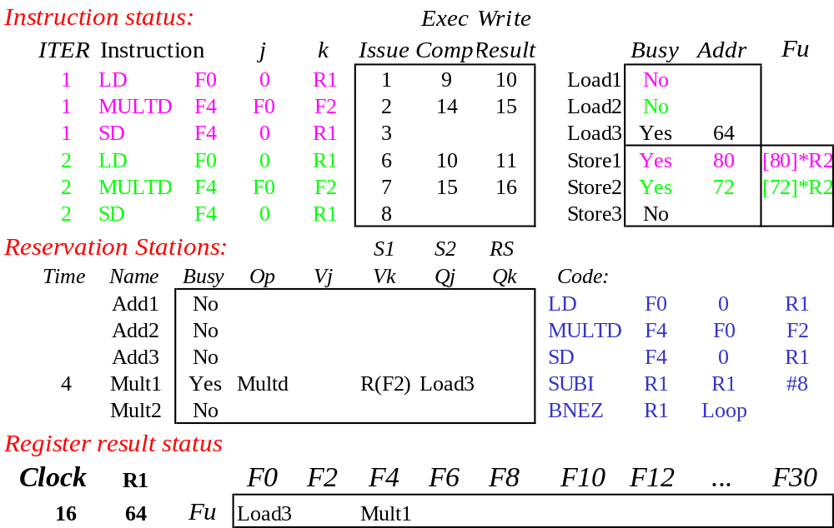
Loop Example Cycle 16

Slide 55
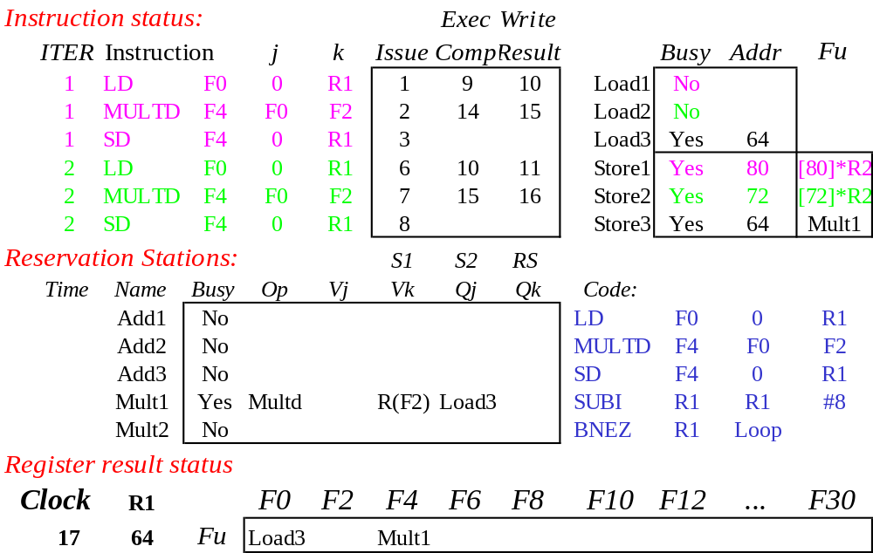
Loop Example Cycle 17

Slide 56

Loop Example Cycle 18

Slide 57
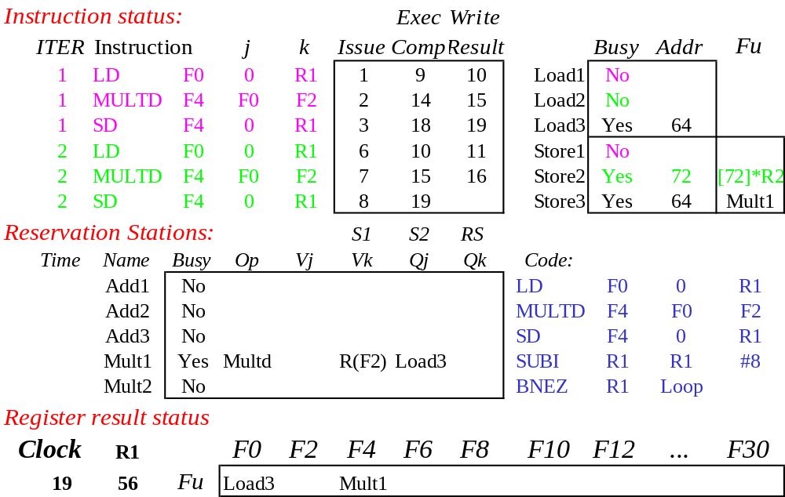
Loop Example Cycle 19

Slide 58
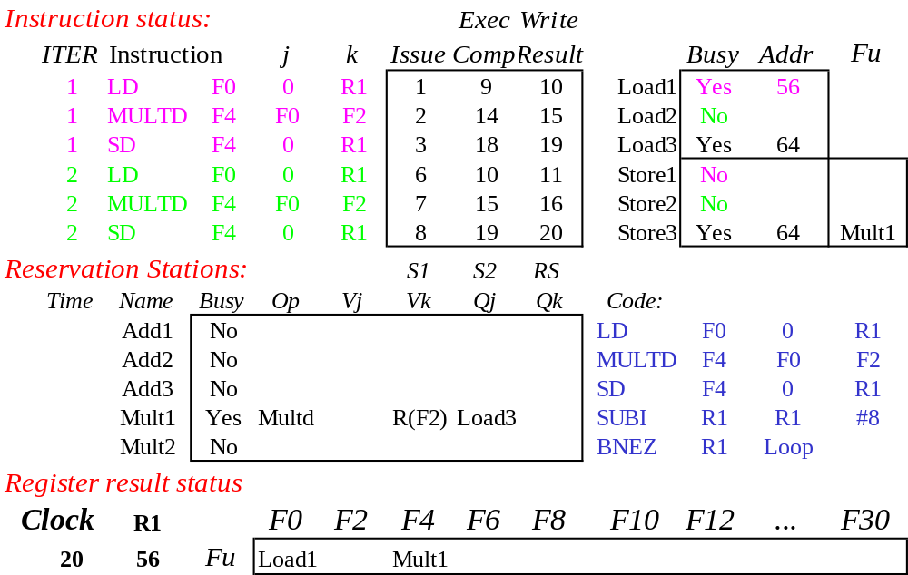
Loop Example Cycle 20
Once again: In-order issue, out-of-order execution and out-of-order completion.

Slide 59
Why can Tomasulo overlap iterations of loops?
Register renaming
  Multiple iterations use different physical destinations for registers (dynamic loop unrolling).
Reservation stations
  Permit instruction issue to advance past integer control flow operations
  Also buffer old values of registers - totally avoiding the WAR stall that we saw in the scoreboard.
Other perspective: Tomasulo builds data flow dependency graph on the fly.

Slide 60
Tomasulo’s scheme offers 2 major advantages
the distribution of the hazard detection logic
  distributed reservation stations and the CDB
  If multiple instructions waiting on a single result, & each instruction has other operand, then instructions can be released simultaneously by broadcasting on CDB
  If a centralized register file were used, the units would have to read their results from the registers when register buses are available.
(2) the elimination of stalls for WAW and WAR hazards

Slide 61
Summary
Reservations stations: implicit register renaming to larger set of registers + buffering source operands
  Prevents registers from being bottleneck
  Avoids WAR, WAW hazards of Scoreboard
  Allows loop unrolling in HW
Not limited to basic blocks
(integer units gets ahead, beyond branches)
Today, helps cache misses as well
  Don’t stall for L1 Data cache miss (insufficient ILP for L2 miss?)
Lasting Contributions
  Dynamic scheduling
  Register renaming
  Load/store disambiguation
360/91 descendants are Pentium III; PowerPC 604; MIPS R10000; HP-PA 8000; Alpha 21264

Slide 62
What about Precise Interrupts?
State of machine looks as if no instruction beyond faulting instructions has issued
Tomasulo had:
In-order issue, out-of-order execution, and out-of-order completion
Need to “fix” the out-of-order completion aspect so that we can find precise breakpoint in instruction stream.

Slide 63
Speculating with Tomasulo
Modern processors such as PowerPC 603/604, MIPS R10000, Intel Pentium II/III/4, Alpha 21264 extend Tomasulo’s approach to support speculation
Key ideas:
  separate execution from completion: allow instructions to execute speculatively but do not let instructions update registers or memory until they are no longer speculative
  therefore, add a final step – after an instruction is no longer speculative – when it is allowed to make register and memory updates, called instruction commit
  allow instructions to execute out of order but force them to commit in order
  add a hardware buffer, called the reorder buffer (ROB), with registers to hold the result of an instruction between execution completion and commit

Slide 64
HW support for precise interrupts
Need HW buffer for results of uncommitted instructions: reorder buffer
  Use reorder buffer number instead of reservation station when execution completes
  Supplies operands between execution completion & commit
  (Reorder buffer can be operand source => more registers like RS)
  Instructions commit
  Once an instruction commits,
  result is put into register
  As a result, easy to undo speculated instructions
  on mispredicted branches
  or exceptions
Reorder
Buffer
FP
Op
Queue
FP Regs
Res Stations
Res Stations
FP Adder
FP Adder

Slide 65
ROB Data Structure
ROB entry fields
Instruction type: branch, store, register operation (i.e., ALU or load)
State: indicates if instruction has completed execution and value is ready
Destination: where result is to be written – register number for register operation (i.e. ALU or load), memory address for store
  branch has no destination result
Value: holds the value of instruction result until time to commit
Additional reservation station field
Destination: Corresponding ROB entry number

Slide 66
Four Steps of Speculative Tomasulo Algorithm
1. Issue—get instruction from FP Op Queue
  If reservation station and reorder buffer slot free, issue instr & send operands & reorder buffer no. for destination (this stage sometimes called “dispatch”)
2. Execution—operate on operands (EX)
  When both operands ready then execute; if not ready, watch CDB for result; when both in reservation station, execute; checks RAW (sometimes called “issue”)
3. Write result—finish execution (WB)
  Write on Common Data Bus to all awaiting FUs
  & reorder buffer; mark reservation station available.
4. Commit—update register with reorder result
  When instr. at head of reorder buffer & result present, update register with result (or store to memory) and remove instr from reorder buffer. Mispredicted branch flushes reorder buffer (sometimes called “graduation”)

Slide 67
What are the hardware complexities with reorder buffer (ROB)?
Compar network
Reorder
Buffer
FP
Op
Queue
Program Counter
Exceptions?
Dest Reg
FP Regs
Result
Valid
Reorder Table
Res Stations
Res Stations
FP Adder
FP Adder
How do you find the latest version of a register?
  (As specified by Smith paper) need associative comparison network
  Could use future file or just use the register result status buffer to track which specific reorder buffer has received the value
Need as many ports on ROB as register file

Slide 68
Speculative Tomasulo Example
LD F0 10 R2
ADDD F10 F4 F0
DIVD F2 F10 F6
BNEZ F2 Exit
LD F4 0 R3
ADDD F0 F4 F9
SD F4 0 R3
…
Exit:

Slide 69
Tomasulo With Reorder buffer:
Dest.
Value
Instruction
Done?
FP Op
Queue
ROB7
ROB6
ROB5
ROB4
ROB3
ROB2
ROB1
Newest
Reorder Buffer
Oldest
F0
LD F0,10(R2)
N
Registers
To
Memory
Dest
Dest
from
Memory
Dest
Reservation
Stations
1 10+R2
FP adders
FP multipliers
Notes:
Resolve RAW memory conflict? (address in memory buffers)
Integer unit executes in parallel

Slide 70
Tomasulo With Reorder buffer:
Dest.
Value
Instruction
Done?
FP Op
Queue
ROB7
ROB6
ROB5
ROB4
ROB3
ROB2
ROB1
Newest
Reorder Buffer
F10
ADDD F10,F4,F0
N
Oldest
F0
LD F0,10(R2)
N
Registers
To
Memory
Dest
Dest
from
Memory
2 ADDD R(F4),ROB1
Dest
Reservation
Stations
1 10+R2
FP adders
FP multipliers
Notes:
Resolve RAW memory conflict? (address in memory buffers)
Integer unit executes in parallel

Slide 71
Tomasulo With Reorder buffer:
Dest.
Value
Instruction
Done?
FP Op
Queue
ROB7
ROB6
ROB5
ROB4
ROB3
ROB2
ROB1
Newest
Reorder Buffer
F2
DIVD F2,F10,F6
N
F10
ADDD F10,F4,F0
N
Oldest
F0
LD F0,10(R2)
N
Registers
To
Memory
Dest
Dest
from
Memory
2 ADDD R(F4),ROB1
3 DIVD ROB2,R(F6)
Dest
Reservation
Stations
1 10+R2
FP adders
FP multipliers
Notes:
Resolve RAW memory conflict? (address in memory buffers)
Integer unit executes in parallel

Slide 72
Skip some cycles

Slide 73
Tomasulo With Reorder buffer:
Dest.
Value
Instruction
Done?
FP Op
Queue
ROB7
ROB6
ROB5
ROB4
ROB3
ROB2
ROB1
Newest
F0
ADDD F0,F4,F6
N
F4
LD F4,0(R3)
N
Reorder Buffer
--
BNE F2,<…>
N
F2
DIVD F2,F10,F6
N
F10
ADDD F10,F4,F0
N
Oldest
F0
LD F0,10(R2)
N
Registers
To
Memory
Dest
Dest
from
Memory
2 ADDD R(F4),ROB1
6 ADDD ROB5, R(F6)
3 DIVD ROB2,R(F6)
Dest
Reservation
Stations
1 10+R2
5 0+R3
FP adders
FP multipliers
Notes:
Resolve RAW memory conflict? (address in memory buffers)
Integer unit executes in parallel

Slide 74
Tomasulo With Reorder buffer:
Dest.
Value
Instruction
Done?
FP Op
Queue
--
ROB5
SD 0(R3),F4
N
ROB7
ROB6
ROB5
ROB4
ROB3
ROB2
ROB1
Newest
F0
ADDD F0,F4,F6
N
F4
LD F4,0(R3)
N
Reorder Buffer
--
BNE F2,<…>
N
F2
DIVD F2,F10,F6
N
F10
ADDD F10,F4,F0
N
Oldest
F0
LD F0,10(R2)
N
Registers
To
Memory
Dest
Dest
from
Memory
2 ADDD R(F4),ROB1
6 ADDD ROB5, R(F6)
3 DIVD ROB2,R(F6)
Dest
Reservation
Stations
1 10+R2
5 0+R3
FP adders
FP multipliers
Notes:
Resolve RAW memory conflict? (address in memory buffers)
Integer unit executes in parallel

Slide 75
Tomasulo With Reorder buffer:
Dest.
Value
Instruction
Done?
FP Op
Queue
--
M[10]
SD 0(R3),F4
Y
ROB7
ROB6
ROB5
ROB4
ROB3
ROB2
ROB1
Newest
F0
ADDD F0,F4,F6
N
F4
M[10]
LD F4,0(R3)
Y
Reorder Buffer
--
BNE F2,<…>
N
F2
DIVD F2,F10,F6
N
F10
ADDD F10,F4,F0
N
Oldest
F0
LD F0,10(R2)
N
Registers
To
Memory
Dest
Dest
from
Memory
2 ADDD R(F4),ROB1
6 ADDD M[10],R(F6)
3 DIVD ROB2,R(F6)
Dest
Reservation
Stations
1 10+R2
FP adders
FP multipliers
Notes:
Resolve RAW memory conflict? (address in memory buffers)
Integer unit executes in parallel

Slide 76
Tomasulo With Reorder buffer:
Dest.
Value
Instruction
Done?
FP Op
Queue
--
M[10]
SD 0(R3),F4
Y
ROB7
ROB6
ROB5
ROB4
ROB3
ROB2
ROB1
Newest
F0
---
ADDD F0,F4,F6
Ex
F4
M[10]
LD F4,0(R3)
Y
Reorder Buffer
--
BNE F2,<…>
N
F2
DIVD F2,F10,F6
N
F10
ADDD F10,F4,F0
N
Oldest
F0
LD F0,10(R2)
N
Registers
To
Memory
Dest
Dest
from
Memory
2 ADDD R(F4),ROB1
3 DIVD ROB2,R(F6)
Dest
Reservation
Stations
1 10+R2
FP adders
FP multipliers
Notes:
Resolve RAW memory conflict? (address in memory buffers)
Integer unit executes in parallel

Slide 77
Notes
If a branch is mispredicted, recovery is done by flushing the ROB of all entries that appear after the mispredicted branch
  entries before the branch are allowed to continue
  restart the fetch at the correct branch successor
When an instruction commits or is flushed from the ROB then the corresponding slots become available for subsequent instructions

Slide 78
Tomasulo Algorithm vs. Scoreboard
Control & buffers distributed with Function Units (FU) vs. centralized in scoreboard;
  FU buffers called “reservation stations”; have pending operands
Registers in instructions replaced by values or pointers to reservation stations(RS); called register renaming ;
  avoids WAR, WAW hazards
  More reservation stations than registers, so can do optimizations compilers can’t
Results to FU from RS, not through registers, over Common Data Bus that broadcasts results to all FUs
Load and Stores treated as FUs with RSs as well
Integer instructions can go past branches, allowing
FP ops beyond basic block in FP queue

Slide 79
Summary
Reservations stations: implicit register renaming to larger set of registers + buffering source operands
  Prevents registers as bottleneck
  Avoids WAR, WAW hazards of Scoreboard
  Allows loop unrolling in HW
Not limited to basic blocks
(integer units gets ahead, beyond branches)
Today, helps cache misses as well
  Don’t stall for L1 Data cache miss (insufficient ILP for L2 miss?)
Lasting Contributions
  Dynamic scheduling
  Register renaming
  Load/store disambiguation
360/91 descendants are Pentium III; PowerPC 604; MIPS R10000; HP-PA 8000; Alpha 21264

